Slide 1
Magda gessler
celebrity from poland

Slide 2
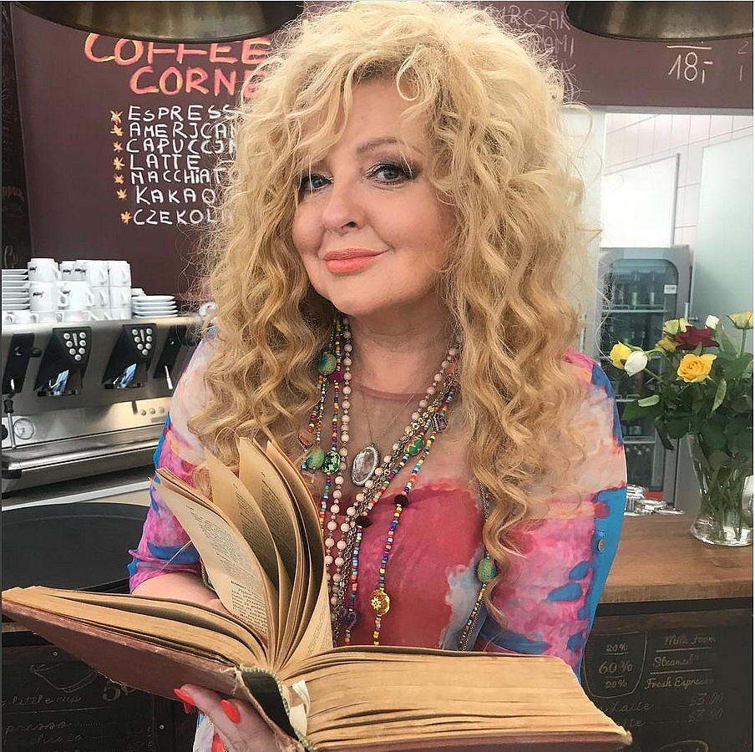
Magdalena daria gessler
born on July 10, 1953 in Komorów. She is a polish restaurateur, painter and the owner and co-owner of several restaurants, a writer and columnist.

Slide 3
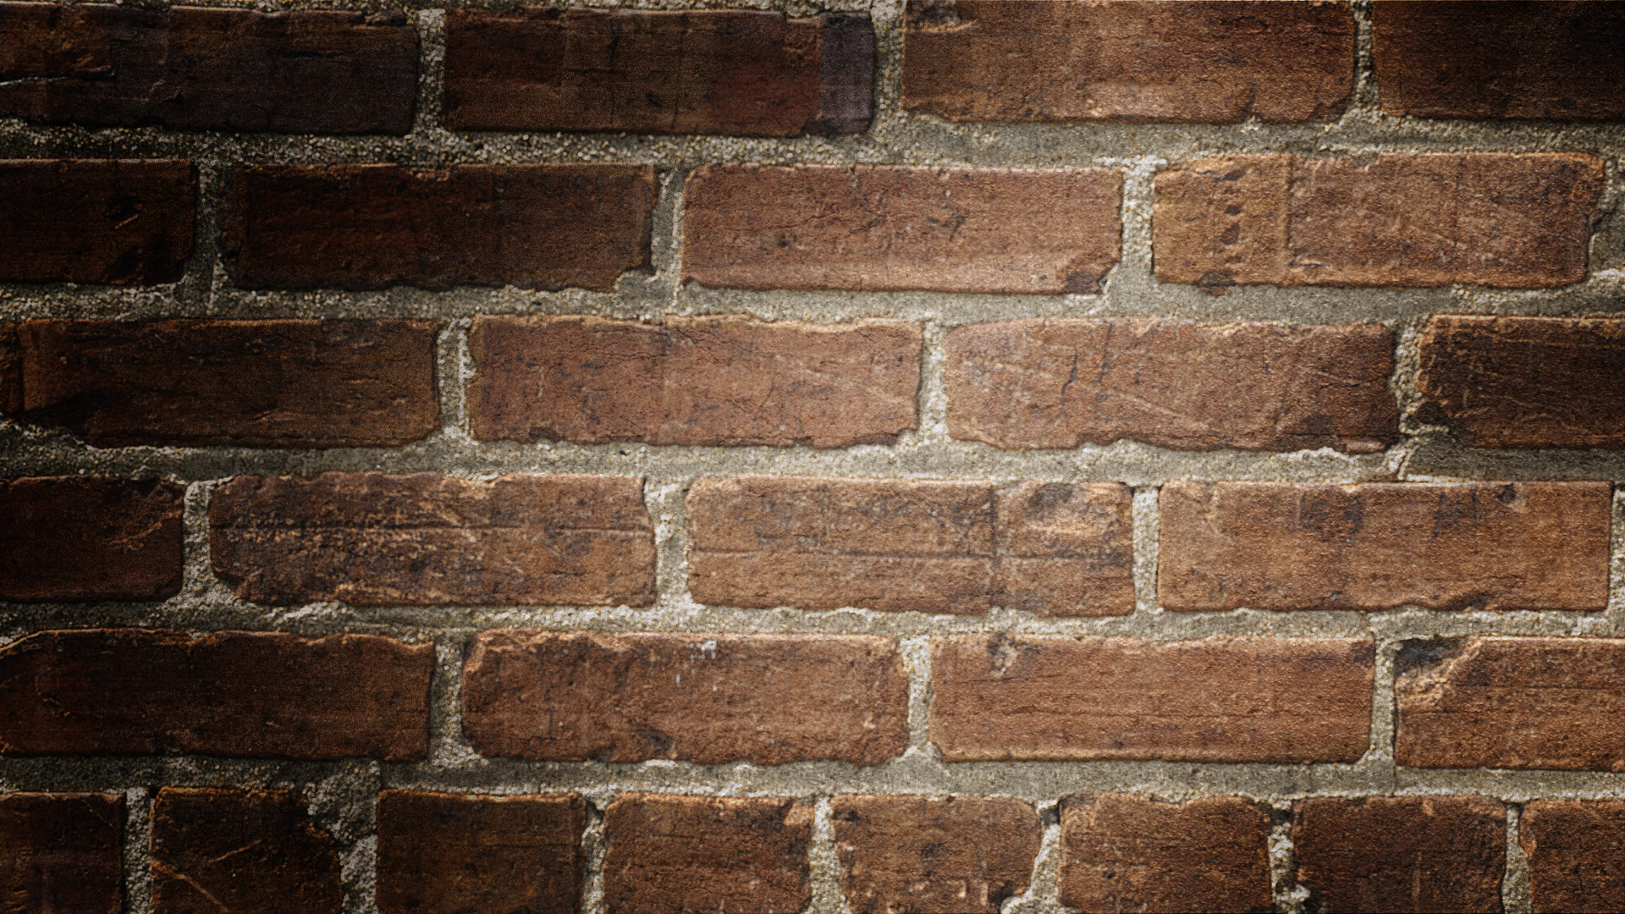
Kuchenne rewolucje - - kitchen revolution
the first episode of kitchen revolutions was broadcast on March 6, 2010. THE PROGRAM IS THAT MRS. MAGDA HELPS OTHER RESTAURANTS AND THEIR OWNERS GET MORE EXPERIENCE.

Slide 4
Masterchef poland
a culinary program whose aim is to select talents from the kitchen amateurs. The show was broadcast for the first time in 1990. Since then, the program has been broadcast in 35 countries around the world. In Poland, the issue of the first edition began on September 2, 2012.

Slide 5
Private life
IN THE 1980S, SHE MARRIED VOLKHART MÜLLER, A CORRESPONDENT FOR THE WEEKLY DER SPIEGEL IN MADRID. AFTER HIS DEATH IN 1986, SHE RETURNED TO POLAND AND MARRIED PIOTR GESSLER, A FAMILY MEMBER OF WARSAW RESTAURATEURS, SON OF ZBIGNIEW GESSLER AND BROTHER ADAM GESSLER. AFTER THE DIVISION OF THE FAMILY BUSINESS IN 1991, PIOTR AND MAGDALENA GESSLER WERE AWARDED THE "U FUKIERA" RESTAURANT IN WARSAW. IT IS SOMETIMES CONFUSED WITH MARTA GESSLER, THE OWNER OF THE "QCHNIA ARTYSTYCZNA" RESTAURANT AND THE FLORIST "WARSZTAT WONI" IN WARSAW. BOTH ARE SUCCESSIVE WIVES OF PIOTR GESSLER, HENCE THE CONVERGENCE OF NAMES. HER CURRENT LIFE PARTNER IS WALDEMAR KOZERAWSKI, WITH WHOM SHE LIVES IN ŁOMIANKI NEAR WARSAW

Slide 6
prizes and awards
2011: Wiktor in the category "The greatest TV discovery". 2012: Telekamera in the TV personality category. 2013: Plejada Top Ten 2013 in the category "Always at the top".

Slide 7
filmography
2008: Niania - as a maid (section 106) 2011: mniam! - as Magda's turtle (dubbing) 2014: na wspólnej - as herself

Slide 8
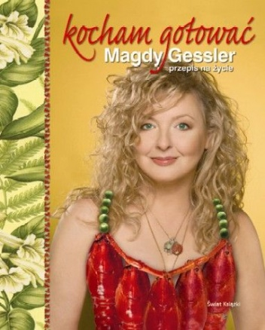
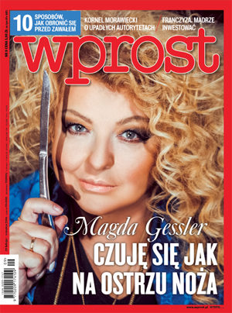
Books
In June 2005, she published the "My Passion Cuisine" book, and in October 2007 I love cooking - Magda Gessler's recipe for life. From June 12, 2010, he writes culinary columns in the weekly magazine "Wprost", and from March 5, 2012 in the weekly Newsweek.

Slide 9
curiosities
Magda speak Fluent in Spanish, German and Italian, she also speaks in English and Portuguese.
In 2018 she confessed that she suffers from paralysis of the trigeminal nerve
She spent her childhood in Sofia and Cuba, which was related to her father's professional activity. She graduated from the XXII LO in Warsaw.
In the 1960s, she and her family lived in Havana, and after a few years in Madrid, where she graduated from painting at the Royal Academy of Fine Arts of St. Ferdinand

Slide 10
The end
Bibliografia: https://pl.wikipedia.org/wiki/Magda_Gessler
Aleksandra oleszczuk
Natalia kusiak
Kl. Vi b, zso nr 8 chełm

